Slide 1
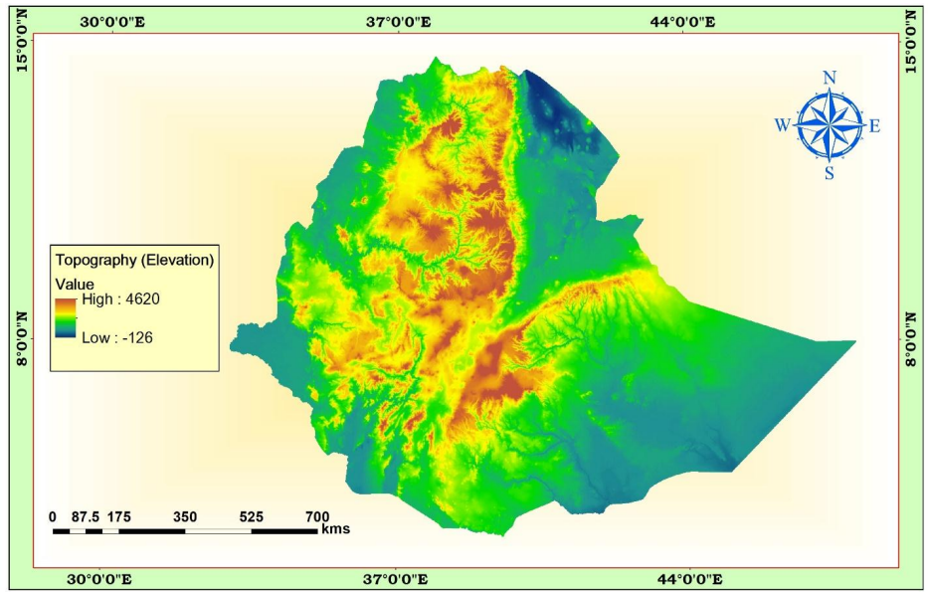
CHAPTER THREE
THE TOPOGRAPHY OF ETHIOPIA
AND
THE HORN

Slide 2
3.1. Introduction
The topography of Ethiopia is largely determined by the geologic activities of the Cenozoic Era.
The uplifting of the Arabo-Ethiopian and
The outpouring and accumulation of Trapean lava
Faulting
General Characteristics of the Ethiopian Physiography
The Ethiopian landform is characterized by great diversity.
There are flat-topped plateaus,
High and rugged mountains,
Deep river gorges and vast plains.
Altitude ranges from 125 meters below sea level (Kobar Sink) to the 4,620 m.a.s.l), Mount Ras Dashen which is the fourth highest mountain in Africa.

Slide 3
Ethiopia has the largest proportion of elevated landmass in the African continent
More than 50% of the Ethiopian landmass is above 1,000 meters
above 1,500 meters makes 44% of the country
above 2,000 meters makes 22% of the country
Most of the Ethiopian Highlands are part of central and northern Ethiopia, and its northernmost portion extends into Eritrea
It is sometimes described as the Roof of East Africa

Slide 4
Cont.…
The highland core, on the other hand, is encircled by semi-arid and lowlands
Dissected by several rivers and ravines which have cut deep gorges.
Are sources of many rivers and streams that made the country to be described as the “Water Tower of East Africa”.
The diversity in topography is accompanied by differences in other natural features such as
Soil, climate, vegetation and wild life.
Socio-cultural and economic phenomena.
Taking the 1,000 meters contour line for the highland-lowland demarcation, one observes the following contrasting features between the Ethiopian highlands and lowlands

Slide 5
Characteristics of Ethiopian highlands:
Moderate and high amount of rainfall (>600 mm per year).
Lower mean annual temperature (<200C).
The climate is favourable for biotic life.
Rain-fed agriculture is possible.
Free from tropical diseases.
Attractive for human habitation and densely settled.
These highlands make up nearly 56% of the area of the Ethiopia. This is further subdivided into:-
lower highland (1,000 - 2,000 m.a.s.l), which make up 34% and
higher highland (>2,000 m.a.s.l) constituting nearly 22%.

Slide 6
Characteristics of Ethiopian Lowlands:
Fewer amounts of rainfall and higher temperature.
High prevalence of tropical diseases.
Lower population densities.
Nomadic and semi-nomadic economic life.
Vast plain lands favourable for irrigation agriculture along the lower river basins.

Slide 7
3.2. The Physiographic Divisions of Ethiopia
Three major physiographic units can be identified in Ethiopia. These are:
The Western highlands and lowlands
The South-eastern (Eastern) highlands and lowlands
The Rift Valley

Slide 8
3.2.1. The Western Highlands and Lowlands
This physiographic unit includes all the area west of the Rift Valley.
It makes up about 44% of the area of the country
This region is further subdivided into four groups of highlands (76.3%) and four groups of lowlands (23.7%)
A. The Western Highlands (76.3%)
The Tigray Plateau (13%)
North Central Massifs(53.3%)
The Shewa Plateau/central highlands(11%)
The Southwestern Highlands(22.7%)
B. The Western Lowlands(23.7%)
Tekeze lowland
Abay-Dinder lowland
Baro lowland
Ghibe lowland

Slide 9
3.2.2. The South-eastern Highlands and Lowlands
is the second largest in terms of area(37% )
The highlands make up 46% of the physiographic division while the rest is lowland.
Further subdivided into two units of highlands and two units of extensive lowlands.
A. The Arsi-Bale-Sidama Highlands South-Eastern High land
B. The Hararghe Plateau
A. The Wabishebelle plain (60%) and South-Eastern Low Land
B. The Ghenale Plain

Slide 10
3.2.3. The Rift Valley
It extends from the Afar triangle in the north to Chew Bahir for about 1,700 km2
It covers 19% of the area of Ethiopia.
It is elongated and funnel shaped, with a NE-SW orientation.
Altitude in the floor ranges from 125bmsl at Dallol Depression, to as high as 2,000 amsl in the Lakes region.
From the floor to the edge of the escarpment, the heights vary from 200 to 1500 meters.
The Rift Valley is further subdivided into three physiographic sub-regions. These are:-
The Afar Triangle,
The Main Ethiopian Rift, and
The Chew Bahir Rift.

Slide 13
3.3. The Impacts of Relief on Biophysical and Socioeconomic Conditions
1. Agricultural practices
Relief influences farm size and shape in that in an area of rugged terrain the farmlands are small in size and fragmented and tend to be irregular in shape.
Choice of farming techniques is highly influenced by relief as:-
In rugged terrain mechanized farming techniques are difficult to practice.
Relief influences crop production as some corps are well adapted to higher altitudes (barley, wheat) and others to low altitude (sorghum, maize).
The practice of animal husbandry is also influenced by relief
sheep are reared in the higher altitudes and camels and goat are well adapted to lower altitudes

Slide 14
2. Settlement pattern
Highlands of Ethiopia that experience a temperate type of climatic condition ….are mainly free from most of the tropical diseases are
Densely settled.
Rugged and difficult terrain hinders the development of settlement and its expansion.
The highlands of Ethiopia are characterized by:-
Sedentary life and permanent settlements while
lowlands that are inhabited by pastoralists have temporary settlements.

Slide 15
3. Transportation and communication
➲ The highly dissected nature of the landscape is a barrier to the development of surface transportation that resulted in the long-term isolation of many communities
➲ The difficult terrain makes infrastructure development and maintenance costly.
➲ TV and radio communications are also highly influenced by relief.
➲ The rugged topography rendered rivers less navigable due to the waterfalls, deep gorges and steep cliffs.

Slide 16
4. Hydroelectric power potential
➲ The great difference in altitude coupled with high rainfall created suitable conditions for a very high potential for the production of hydroelectric power in Ethiopia
5. Socio-cultural feeling
The rugged terrain as a result of excessive surface dissection resulted in the long-term isolation of communities that led to the occurrence of cultural diversity.
➲ People who live in the highlands have been identifying themselves as degegnas (mountaineers) and those who live in the lowlands as kollegnas (lowlanders).

Slide 17
6. Impacts on climate
➲ The climate of Ethiopia is a result of the tropical position of the country and the great altitudinal variation of the general topography.
➲ Highlands with higher amount of rainfall and lower rate of evapo-transpiration tend to be moisture surplus compared to the moisture deficit lowlands.
7. Impacts on soil
Steep mountain slopes provide low angle of rest, unstable surface materials and subject to degradation processes and relatively form shallow and little developed soils.
8. Impacts on natural vegetation
➲ Relief through its effect on climate and hydrology affect the type of natural vegetation grown in an area

